Slide 1
SpaceX Falcon 9 Landing Predictions
IBM Applied Data Science Capstone Project
Jerry Britto J
14-06-24

Slide 2
OUTLINE
Executive Summary
Introduction
Methodology
Results
Conclusion

Slide 3
EXECUTIVE SUMMARY
Process summary:
Data collection
Data wrangling
Exploratory Data Analysis (EDA) with data visualization
EDA with SQL
Building an interactive map with Folium
Building a Dashboard with Plotly Dash
Predictive analysis – Classification
Results summary:
EDA results
Interactive results
Predictive analysis

Slide 4
INTRODUCTION
Problem Statement:
SpaceX advertises rocket launches on its website, with a cost of 62 million dollars, other providers cost upward of 165 million dollars each, much of the savings is because SpaceX can reuse the first stage. If we can determine whether the first stage can land successfully then we can determine its cost of launch.
Problem Solution:
This project is to predict if the Falcon 9 first stage will land successfully. Set of features are given about Falcon 9 rocket launch such as its payload mass, orbit type, launch site etc.

Slide 5
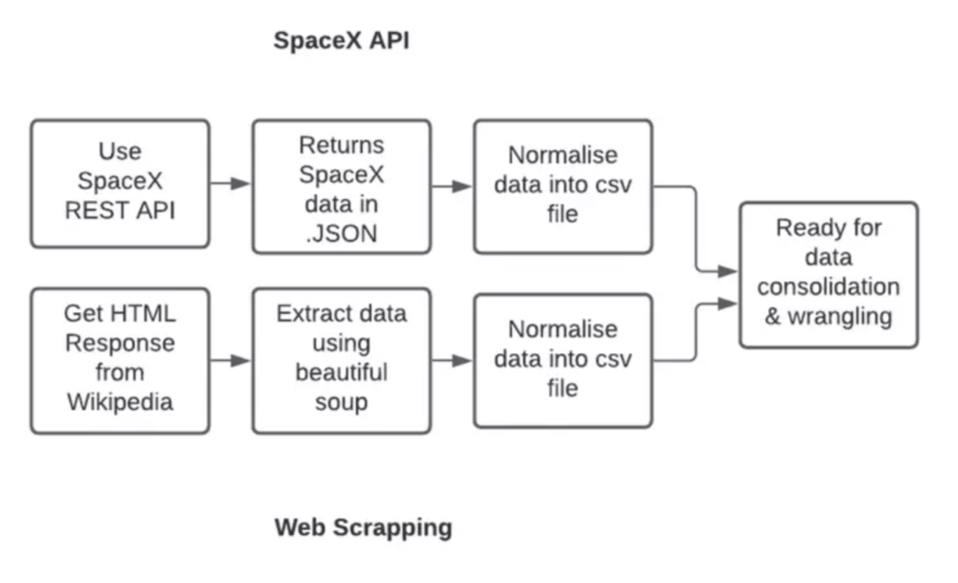
METHODOLOGY
DATA COLLECTION:
SpaceX launch data that is gathered from REST API.
This API will give us the required data about launches and rocket’s set of features.
The SpaceX REST API endpoints, or URL starts with api.spacexdata.com/v4/.
Another popular method for obtaining required data is Web scraping Wikipedia using BeautifulSoup.

Slide 6
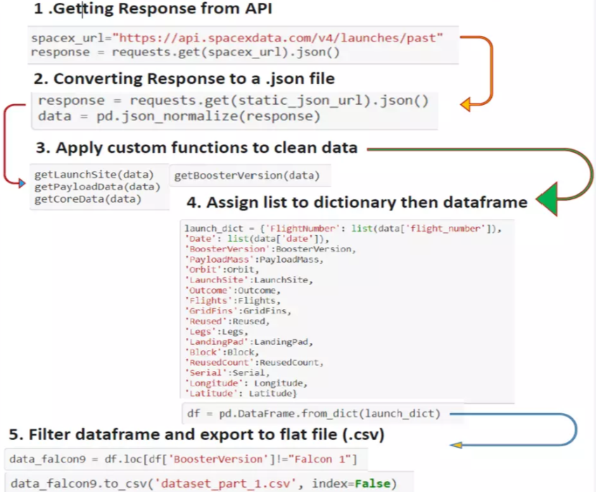
METHODOLOGY
DATA COLLECTION – SpaceX API:
Data collection with SpaceX REST API calls.

Slide 7
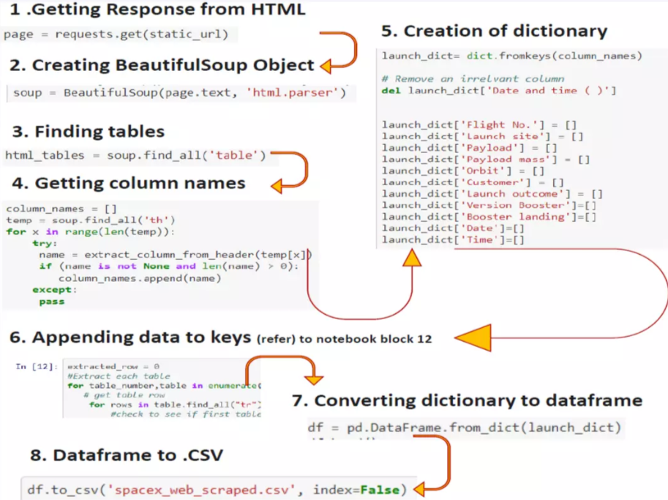
METHODOLOGY
DATA COLLECTION – Webscraping:
Data collection using Webscraping from Wikipedia.

Slide 8
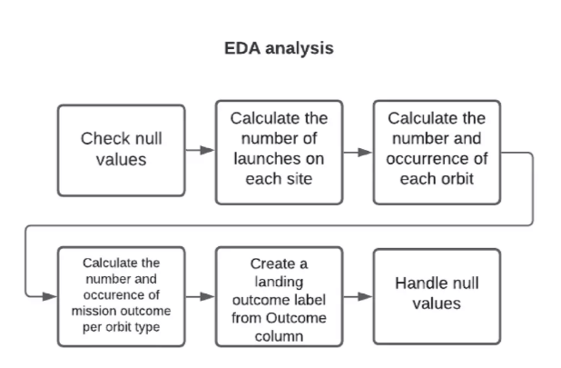
METHODOLOGY
DATA WRANGLING:
The data is later processed so that there are no missing entries and categorical values are encoded using one-hot encoding.
An extra column called ‘Class’ is added to data frame. It contains 0 if launch is failed and 1 if successful.

Slide 9
METHODOLOGY
3) EXPLORATORY DATA ANALYSIS (EDA):
Pandas and NumPy:
Functions from Pandas and NumPy libraries are used to derive info. about data collected, which includes:
The no. of launches on each launch site
The no. and occurrence of each mission outcome
The no. of occurrence of each orbit

Slide 10
METHODOLOGY
4) EDA WITH SQL:
SQL:
The data is queried using SQL to answer questions such as:
The names of unique launch sites
The total payload mass
The average payload mass

Slide 11
METHODOLOGY
5) EDA WITH DATA VISUALIZATION:
Matplotlib and Seaborn:
Functions from Matplotlib and Seaborn libraries are used to visualize data through scatterplots, bar charts and line charts. They are used to understand about relation between features such as:
The relation b/w flight no. and launch site
The relation b/w payload mass and launch site
The relation b/w success rate and orbit type
Folium
The data is queried using SQL to answer questions such as:
Mark all launch sites on map
Mark succeeded and failed launches for each site on map
Mark distance b/w launch site to its proximities such as nearest city, airport, coastline, highway etc.

Slide 12
METHODOLOGY
5) EDA WITH DATA VISUALIZATION:
Dash:
Functions from Dash are used to generate interactive site where input can be given using dropdown menu and range slider.
Using pie chart and scatterplot, the interactive site shows information such as:
The total successful launches from each launch site
The correlation b/w payload mass and mission outcome for each launch site

Slide 13
METHODOLOGY
6) MACHINE LEARNING PREDICTION:
Functions from Scikit library are used to create our machine learning models.
The machine learning prediction phase includes:
Standardizing the data
Splitting data into training and test data
Creating machine learning models include:
Logistic regression
Support Vector Machine (SVM)
Decision tree
K nearest neighbours (KNN)
Fit the models on training set
Find the best combination of hyperparameters for each model
Evaluate models based on their accuracy score and confusion matrix

Slide 14
RESULTS
EDA with SQL (SQL)
EDA with Data Visualization (Matplotlib and Seaborn)
Folium (Map)
Dash (Dashboard)
Predictive Analysis

Slide 15
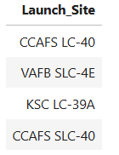
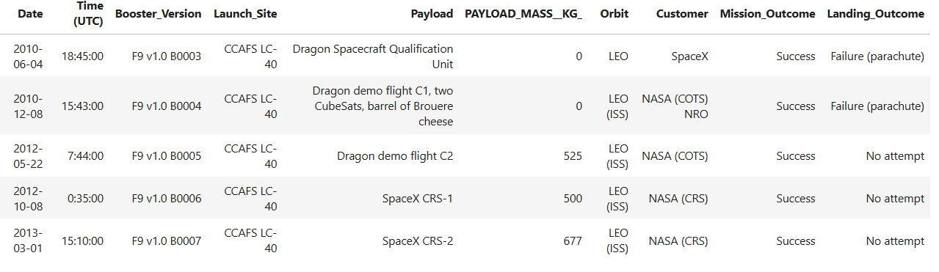
RESULTS – EDA with SQL
1. Display the names of the unique launch sites in the space mission
2. Display 5 records where launch sites name starts with ‘CCA’

Slide 16



RESULTS – EDA with SQL
3. Display Total payload mass carried by boosters launched by NASA (CRS)
4. Display avg payload mass carried by booster F9 v1.1
5. Display date when first successful landing in ground pad achieved

Slide 17
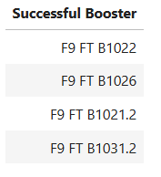
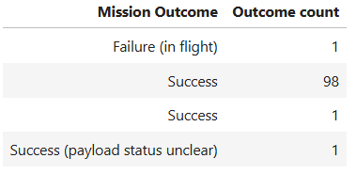
RESULTS – EDA with SQL
6. Display names of the boosters which have success in drone ship and have payload mass greater than 4000 but less than 6000
7. Display total number of successful and failure mission outcomes

Slide 18
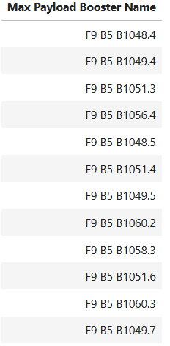
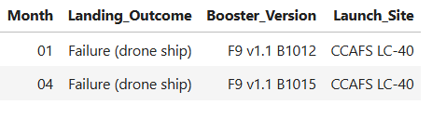
RESULTS – EDA with SQL
8. Display the names of the booster versions which have carried the maximum payload mass
9. Display the records which will display the month names, failure landing outcomes in drone ship, booster versions, launch site for the months in year 2015

Slide 19
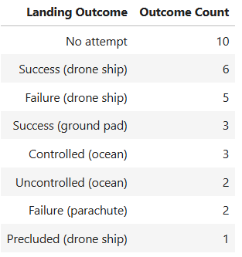
RESULTS – EDA with SQL
10. Display the count of landing outcomes between the date 2010-06-04 and 2017-03-20, in descending order

Slide 20
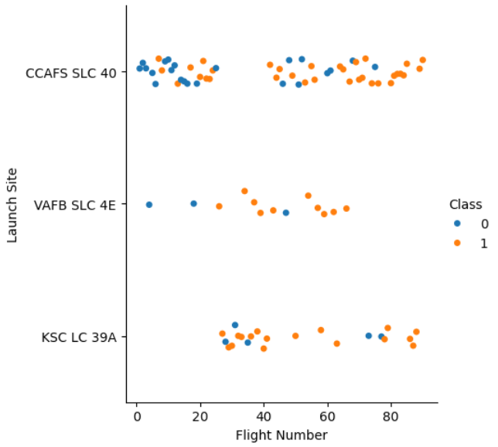
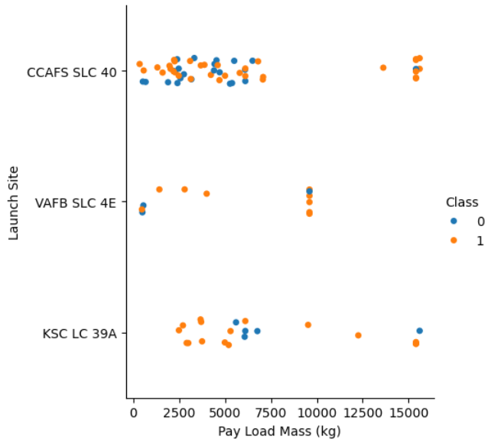
RESULTS – EDA with Visualization
1. Relation b/w Flight no. and Launch site
2. Relation b/w Payload mass and Launch site

Slide 21
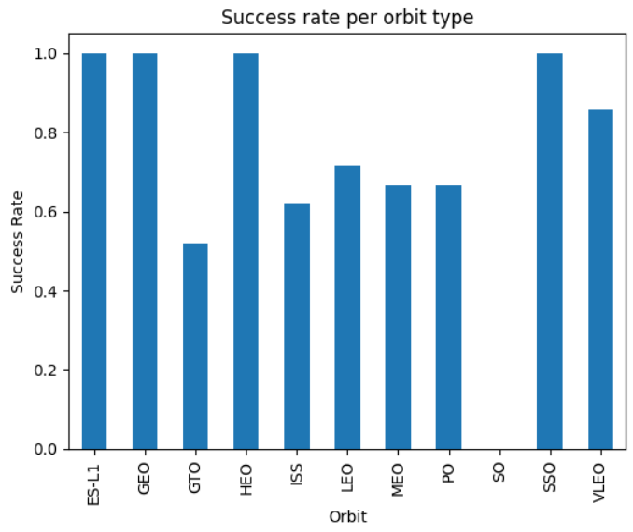
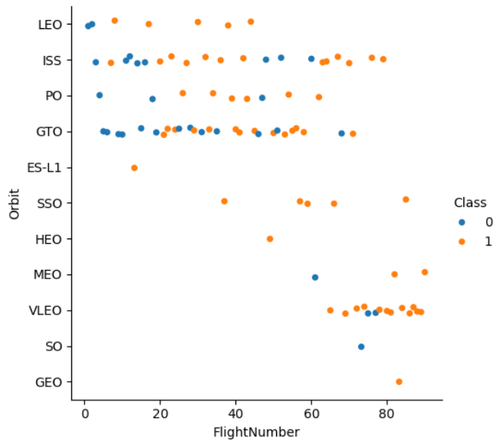
RESULTS – EDA with Visualization
3. Relation b/w Success rate and Orbit type
4. Relation b/w Flight no. and Orbit type

Slide 22
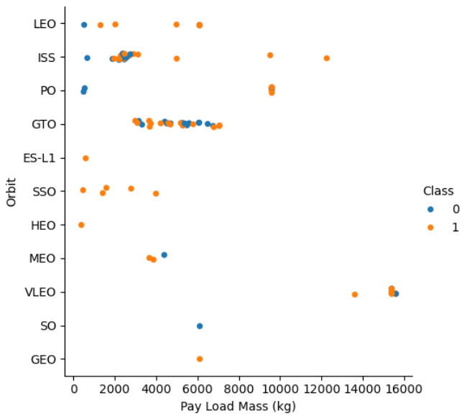
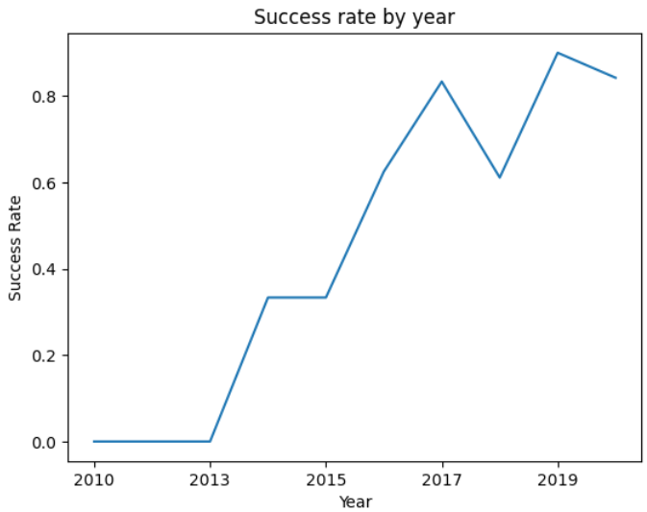
RESULTS – EDA with Visualization
5. Relation b/w Payload mass and Orbit type
6. Launch success rate by year

Slide 23
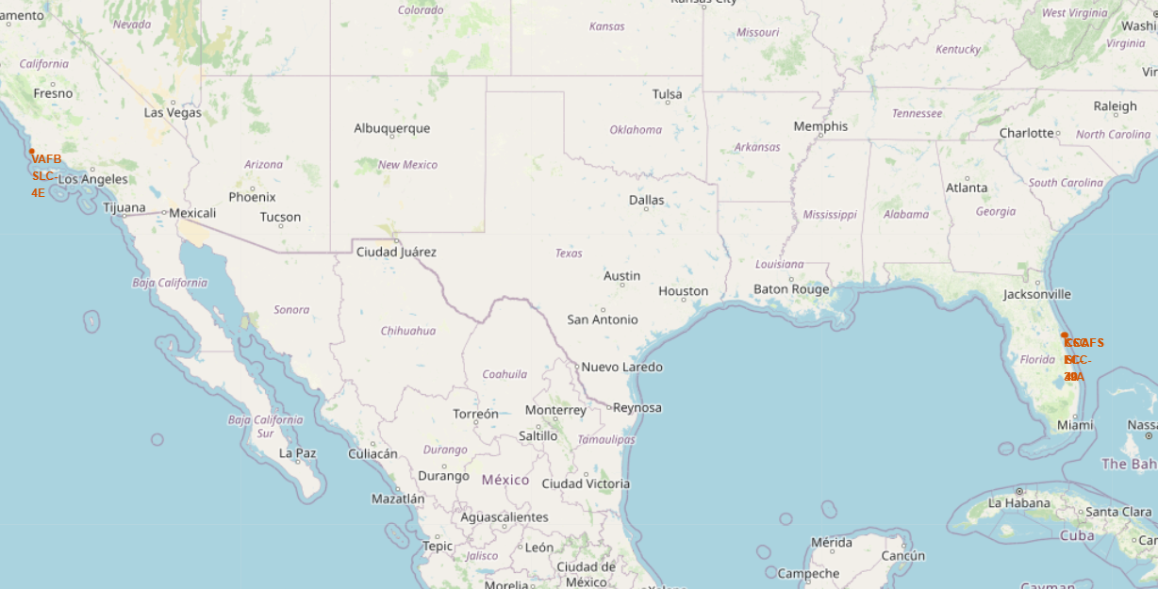
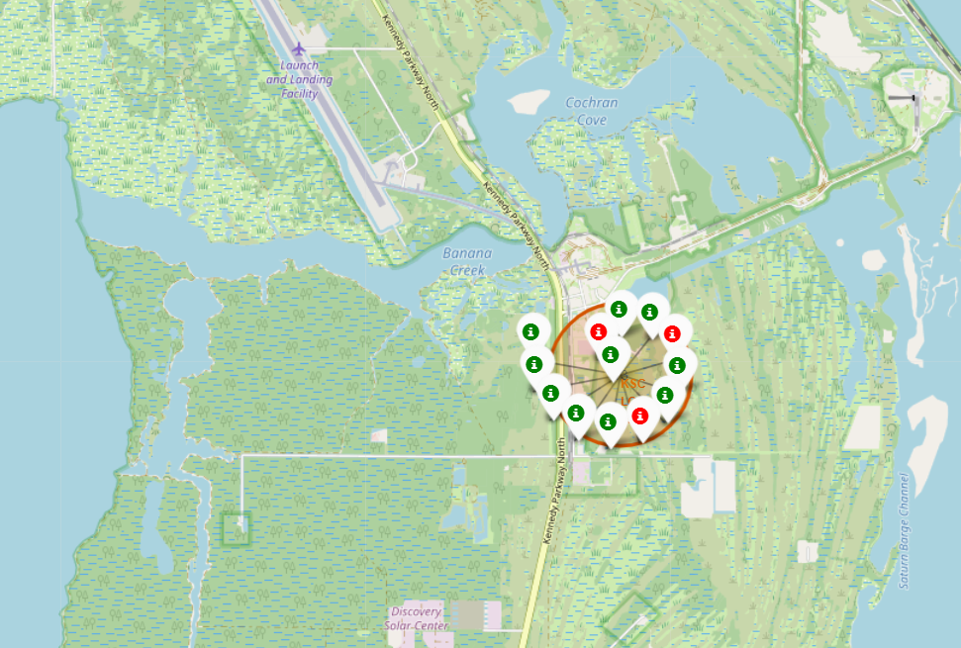
RESULTS – Folium
1. All Launch sites plotted on map
2. Successful and failed launches for each site on map (Green tag – success, Red tag – Fail)

Slide 24
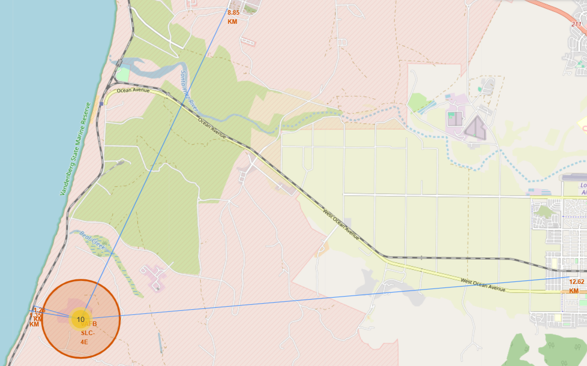
RESULTS – Folium
3. Distance between each launch sites and its proximities such as nearest city, airport, coastline etc.

Slide 25
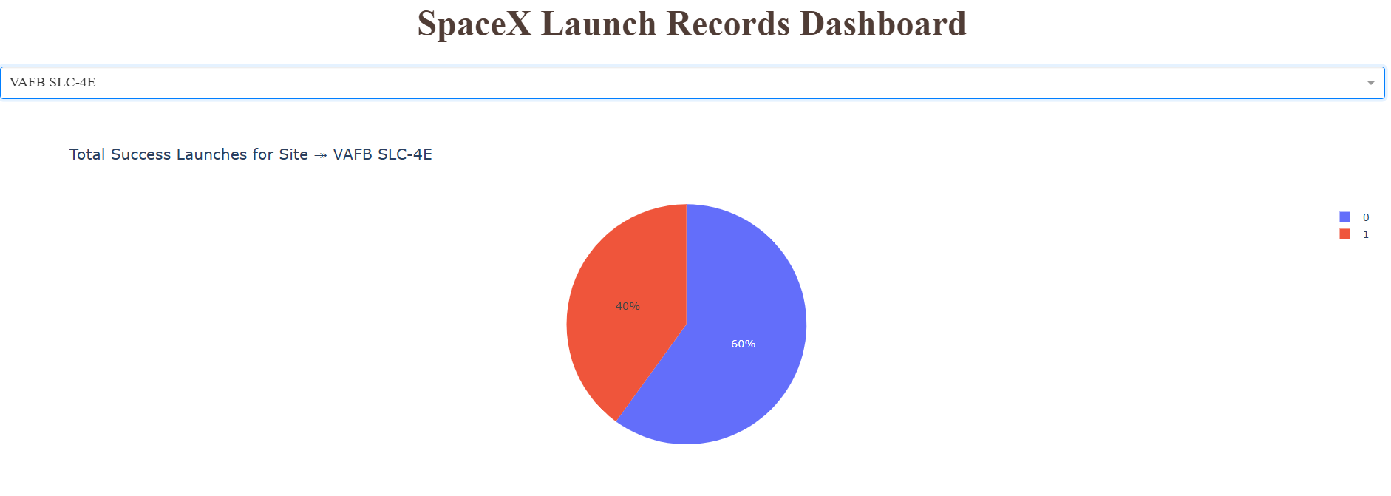
RESULTS – Dash
Below picture shows a pie chart of launch site VAFB SLC-4E when selected from the dropdown menu.
From this we can infer that 60% of launches form this site are failed and only 40% are successful
(0 – Fail , 1 – Success).

Slide 26
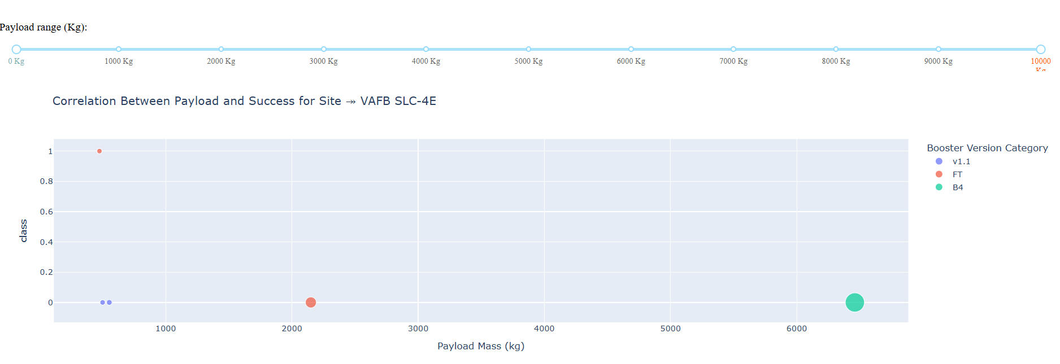
RESULTS – Dash
Below picture shows a scatterplot when payload mass range is set from 0kg to 10000kg.
Class 0 represents Failed and Class 1represents successful launches.

Slide 27
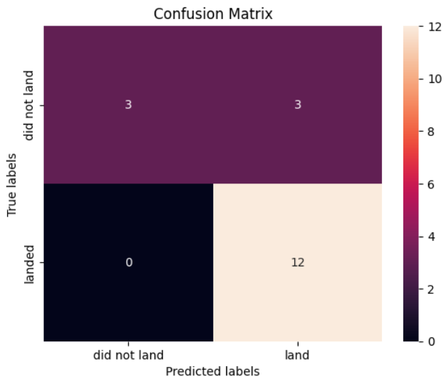
RESULTS – Predictive Analysis
Logistic Regression:
GridSearchCV best score: 0.8464285714285713
Accuracy score: 0.8333333333333334
Confusion matrix:

Slide 28
RESULTS – Predictive Analysis
Support Vector Machine (SVM):
GridSearchCV best score: 0.8482142857142856
Accuracy score: 0.8333333333333334
Confusion matrix:

Slide 29
RESULTS – Predictive Analysis
Decision Tree:
GridSearchCV best score: 0.8892857142857142
Accuracy score: 0.8333333333333334
Confusion matrix:

Slide 30
RESULTS – Predictive Analysis
K Nearest Neighbours (KNN):
GridSearchCV best score: 0.8482142857142858
Accuracy score: 0.8333333333333334
Confusion matrix:

Slide 31
RESULTS – Predictive Analysis
All the 4 models that we have created and tested share the same accuracy score and confusion matrix.
Hence, based on GridSearchCV best scores we rank the models in the following order from best to worst.
Decision tree – GridSearchCV best score: 0.8892857142857142
K nearest neighbours (KNN) – GridSearchCV best score: 0.8482142857142858
Support vector machine (SVM) – GridSearchCV best score: 0.8482142857142856
Logistic regression – GridSearchCV best score: 0.8464285714285713

Slide 32
CONCLUSION
We have successfully determined the best model to predict whether the first stage of SpaceX Falcon 9 launch will land successfully or fail to land in order to determine the cost of launch.
Low weighted payloads perform much better than heavier payloads.
The success rates for SpaceX launches is directly proportional to time in years they will eventually perfect the launches.
KSC LC 39A had the most successful launches from all the sites.
The predictive model produced by decision tree algorithm performed the best among all the four machine learning algorithms employed.

Slide 33
THANK
YOU!

